Slide 1
K. hariharan
DAWN OF INTELLIGENCE

Slide 2
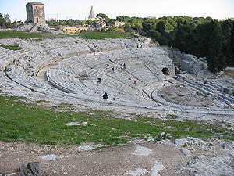
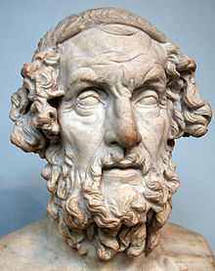
Greece
The rationality of Aristotle, Socrates seems to contrast sharply with the allegorical world of storytelling and performance as seen in the Iliad and Odyssey by Homer (650 BCE)
They used Mythical gods and goddesses to address some of their own social issues like we did in India. Why?
1

Slide 3
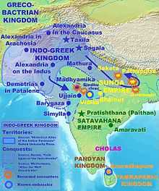
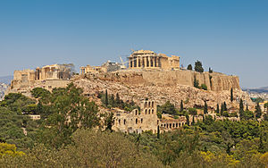
greece
The Hellenistic Greek Language with its Indo-European Connection dominated the world of Homer’s plays
Greek Alphabets became the standard basis for Mathematical terms for all times
The City State or the Concept of the Polis was evolved

Slide 4
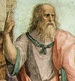
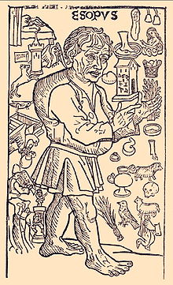
greece
‘The Republic’ by Plato becomes the most fundamental textbook for all political theories to come
The question of Justice is discussed in the most elaborate details. Can you describe the various aspects of such a discourse as heard in the fables of Aesop (564 BCE)?
Does the dispassionate Objectivity of rulers result in such metaphorical interpretations?

Slide 5
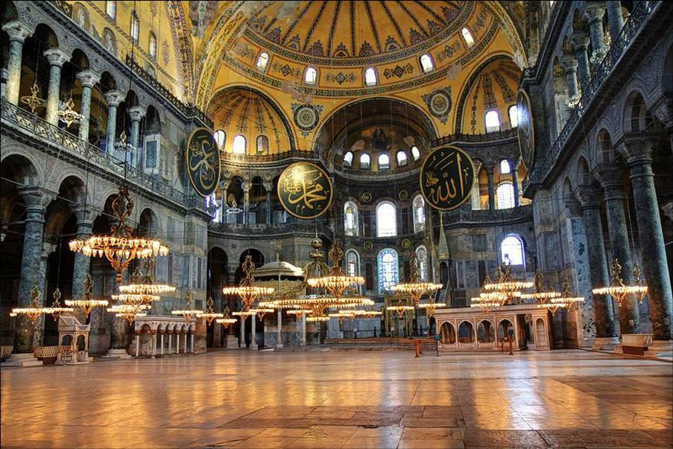

Slide 6
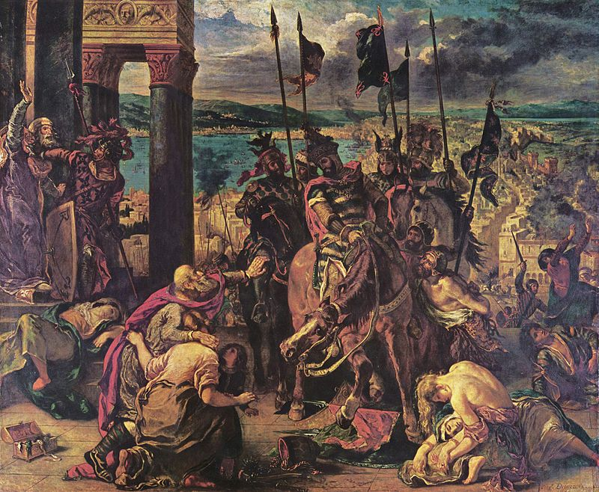
Turkey and the middle east
It starts with Augustus being crowned emperor in 27 BCE and his powers extended slowly and by 272 CE, Constantin 1 became the emperor to take over Turkey from the Assyrians.
Constantinople was firmly established as the new capital
By 370 Christianity became the official religion and the Hagia Sophia established
By 674 the Arabs took over and established the Islamic Caliphate which would rule until 1940

Slide 7
Turkey and the middle east
Islam was rather tough against entertainment and anything that provoked desire
That is probably why it ventured so strongly into the world of Mathematics and Technology.
Al Khwarizmi and Omar Khayyam expanded the horizons of algebra and geometry which was to impact their architecture also in powerful ways
An Arabic writer said ‘the ink of a scholar was holier than the blood of a martyr’!

Slide 8
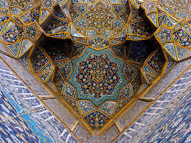
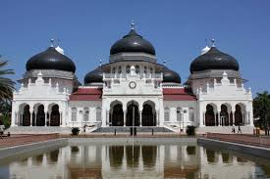
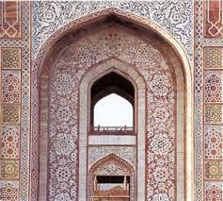
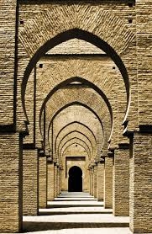
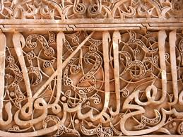

Slide 9


Turkey and the Middle east
What and why do you think the Arabs devoted so much time and effort into the art of calligraphy and evolved the geometric form of the Dervish Dance?
What are the lessons being imparted by Mulla Nasrudin?
2

Slide 10
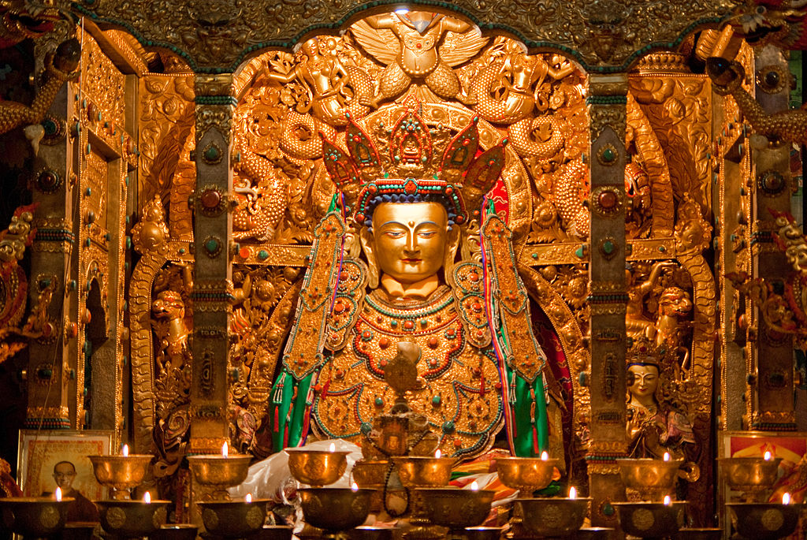

Slide 11
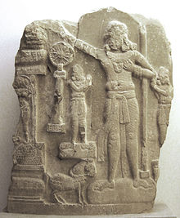
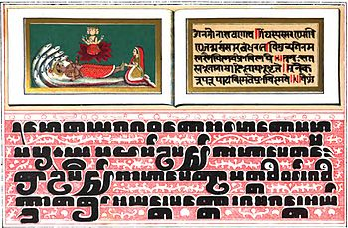
Tibet and North India
Buddhism made a strong impact with its very egalitarian philosophy thru Pali language and stories depicted in the Jataka Tales. Explain
Asoka was one of the first to follow this path and dedicate himself to establishing an Ethical monarchy
Jainism retained Sanskrit as its main language

Slide 12
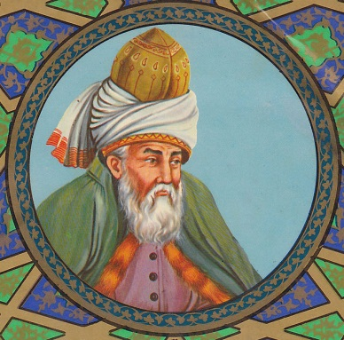
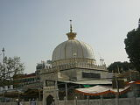
Tibet and North India
The coming of Islam into North India resulted in a wonderful zone of wisdom called Sufism
The works of Jalaludin Rumi or Mawlana (1250 CE) spread the simple mystic ways of looking at the world and remaining true to oneself
Khwaja Moinuddin Chisti set himself up as the first promoter of Sufism in Ajmer at the same time!

Slide 13
Tibet and North India
The biggest change however comes with the Bhakti Movement with great composers like Gnyaneshwar, Tukaram and Namdev
Finally it influences the dance and several performing traditions in the popular domain
Study the poems of Kabir and explain how he is connected with the other traditions that you have heard so far.
3

Slide 14
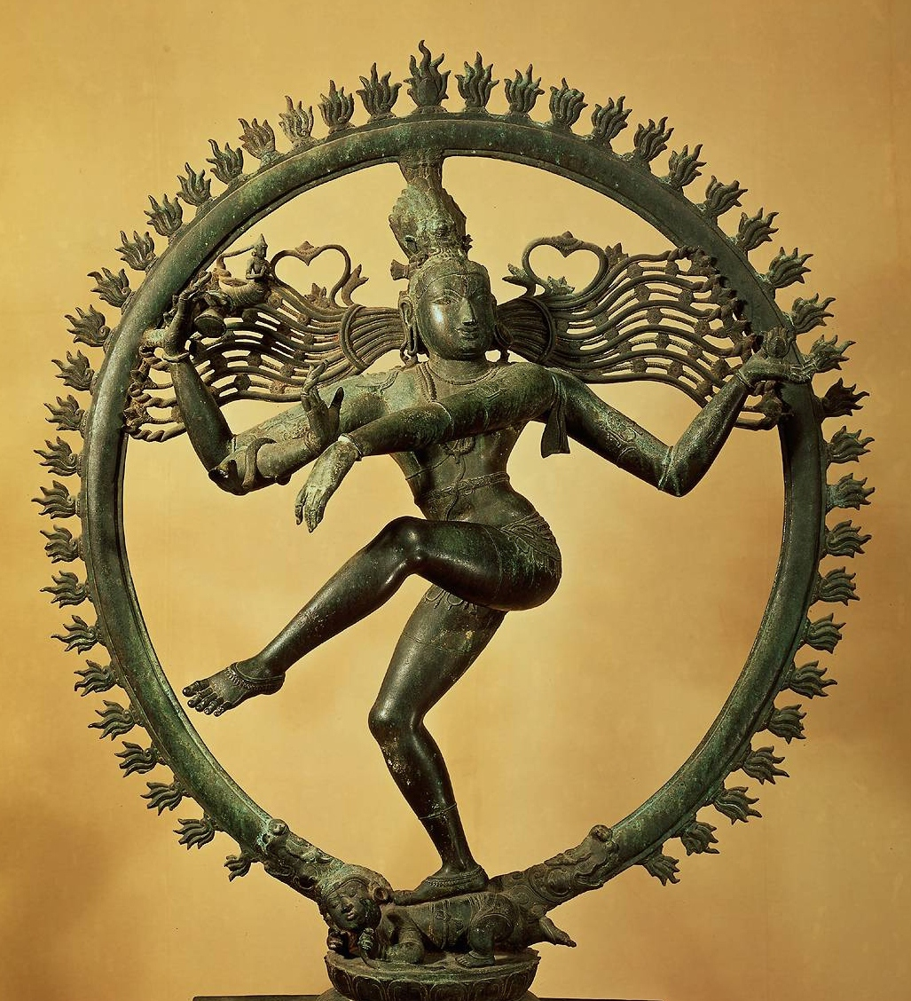

Slide 15
SOUTH INDIA
The south of India is one of the biggest game-changers in this period of intelligence
Both Jainism and Buddhism meet with the matriarchal deities in the south and give birth to a variety of complex architectural styles, iconography and performing arts.
The mask in the performance assumes great importance. Why?
4

Slide 16
SOUTH INDIA
The philosophy of Advaita Vedanta as propagated by Adi Sankara would have some serious implications on thinkers around the world
The regional languages blossom with some of the finest stories and poems ever composed to inaugurate the Bhakti movement
Study these poems by Akka Maha Devi (1150 CE) from Karnataka and comment as to why she was called a ‘Mad Devotee’

Slide 17
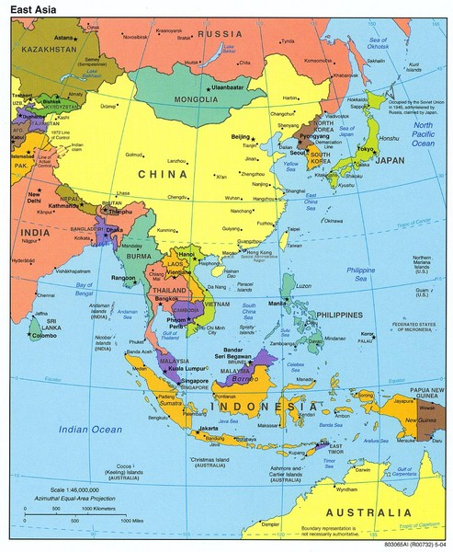

Slide 18
SOUTH ASIA AND THE FAR EAST
The dawn of the millennium belonged, in many ways to South Asia and the Far East. Tribal, urban and rural societies co-existed, speaking several languages
If India was the highest producer of grain, then the Japanese and Chinese developed metallurgy and textiles in big ways
But due to conflicting schools of Buddhism and powerful authoritarian emperors, they bought untold misery also to the common people

Slide 19
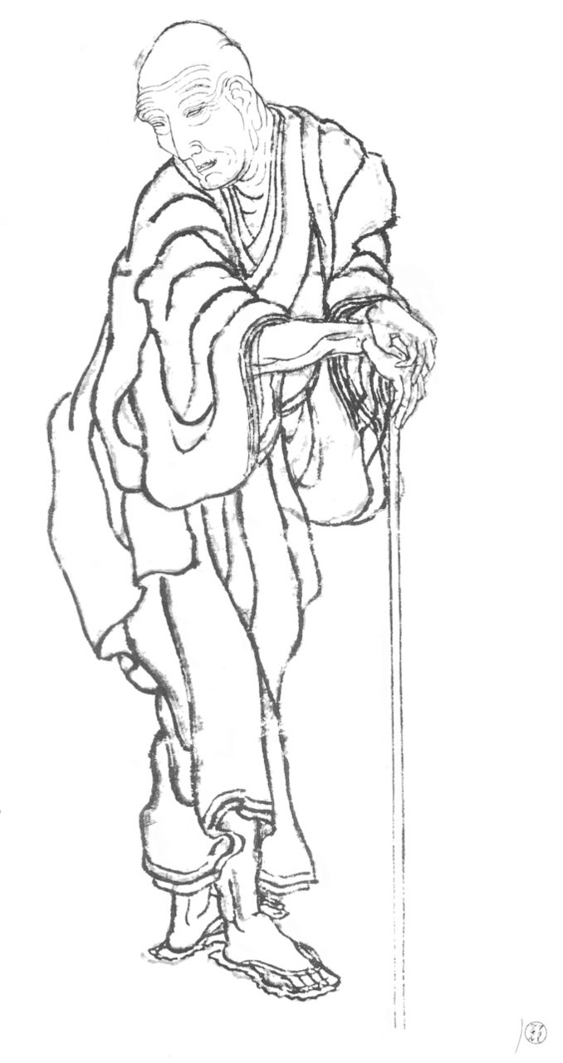
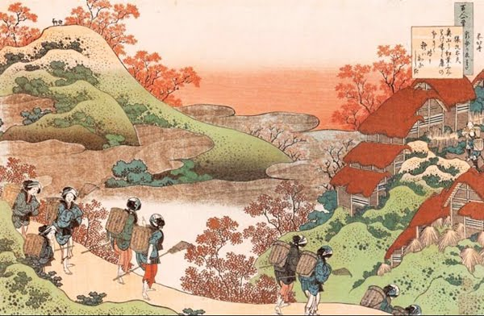
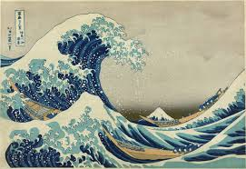
SOUTH ASIA AND THE FAR EAST
Was that the reason why their poems and paintings were so stylised and minimal?

Slide 20
SOUTH ASIA AND THE FAR EAST
The performing arts of Japan and China were even more formal, completely denying itself the need for human warmth and psychological understanding. Strangely they did not develop the kind of myths that other societies were nurturing
Study the Zen poems provided and give us your conclusions
All the best
5

